Slide 1
Moneybol
Louis Cheng, Mackenzi Stevenson, Ethan Bondick, and Francesco Staudacher

Slide 2
Project goal
Given a set of constraints (budget, players per position, minimum acceptable statistics, etc.) can we build the optimal soccer team to compete in the Premier League?

Slide 3
Problem Breakdown
Problem 1 - Player Evaluation
Can we determine what stats to focus on and relate team stats to individual stats?
Can we implement a ranking algorithm that can rank a player’s performance?
Problem 2 – Team Optimization
How do we go about solving the multi-target optimization problem of a team?
What exactly are we optimizing?
What’s the “value-add”?
We want to create a tool that can allow managers to use data-driven decisions for roster formation, eliminating “hype” and ”word-of-mouth” from recruiting.

Slide 4
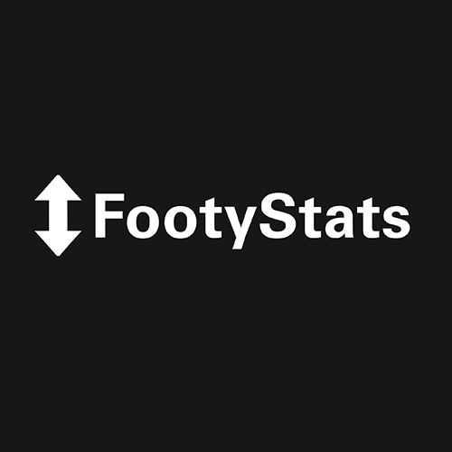

Data sourcing
Initially, data was pulled from FootyStats – using the last two years of player data and the last five years of match data. As a secondary source, our team scraped data directly from the BPL Website– allowing us to build a player-level “average stats per-game” database.
From individual seasons, we built an aggregate database and then used it in our EDA and ML tasks to determine feature performance and player efficacy.
After initial stats analysis, it was necessary to pull salary information on the players in our database. We scraped this data from spotrac – pulling the most recent salary figures for players in the 2017-2022 period.
FootyStats Python Script
Premier League Scraper Script
Spotrac Salary Scraper Script

Slide 5
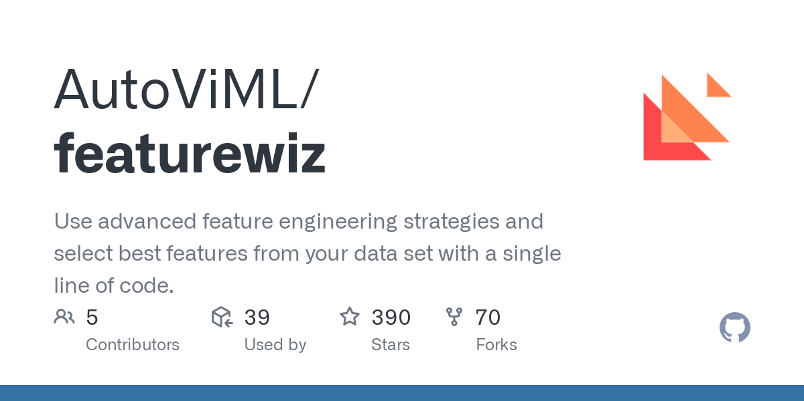

Strategies
EDA (Exploratory Analysis) - Link
We wanted to find “differentiator features” – i.e. features that set the top 4 teams apart and were statistically significant, as well as understand more about the statistical makeup of the BPL
PCA/Feature Selection – League, Player, Match, Cluster
Use “FeatureWhiz” to remove highly correlated features
Use XGBoost to perform gradient-boosted feature selection
Optimization - Link
Begin with budget, and set custom weighting for cluster analysis
GUI Creation - Link
Use Tkinter package to create a user-friendly interface

Slide 6
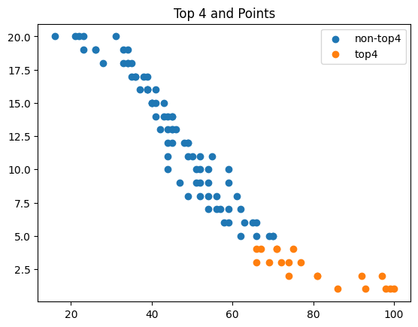
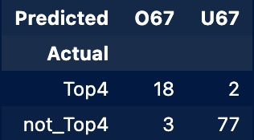
EDA Findings
Initial goal with EDA was to look more statistically at the – both team-wise and player-wise.
Cutoff of 67 points to make the top 4 and qualify for Champions League yielded the highest accuracy

Slide 7
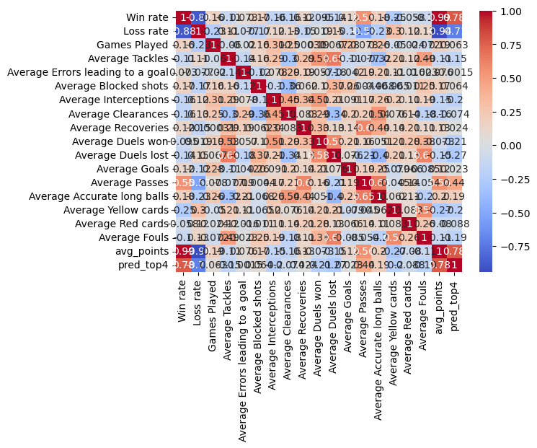
EDA Findings
The output to the right is the correlation table generated when looking at player-by-player data scraped from the Premier League website
A few notable correlations:
“Win Rate” and “Top 4”
“Average Duels Lost” and “Average Tackles”
“Average Passes” and “Average Recoveries”
“Average Fouls” and “Average Duels Lost”
“Average Points” and “Win Rate/Loss Rate”
“Average Passes” and “Win Rate”
“Win Rate” and “Loss Rate”

Slide 8
EDA Findings
Our initial goal was to find “differentiator features”
This analysis was performed using the BPL Dataset we scraped – along with the idea of splitting the league into “Top 4” and “Not Top 4”
BPL keeps stats by player for “all-time,” thus we divide each stat by Games Played to create average stats.
Using a paired t-test, we look for features that set the top four apart
Defenders: Average Passes, Average Duels (lost/won), Average Yellow Cards, Average Interceptions, Average Accurate Long Balls, Average Fouls
Midfielders: Average Passes, Average Assists, Average Goals, Average “Big Chances” Created, Average Games Played
Forwards: Average Goals, Average Shots on Target, Average Assists, Average Passes, Average “Big Chances” Created, Average “Big Chances” Missed, Games Played, Average Penalties Scored, Average ”Hit Woodwork”
Goalkeepers: Average Clean Sheets, Average Goals Conceded, Average Saves, Average Accurate Long Balls
All these stats pass the “logic test” – it makes sense that they would be important as differentiators.

Slide 9
Feature Selection
Started with feature selection on League-wide statistics
Through FeatureWiz and a basic Linear Regression model, our team estimated the importance of each stat to the season performance of a team.
Through this we found two relevant objectives to optimize:
“Goals Scored per Match”
“Clean Sheets”
We split these objectives as a goal to be completed by different sections of players
We used Attackers to determine what stats contribute to Goals Scored
We used Defenders and Goalkeepers to determine what stats contribute to Clean Sheets
Using these objectives, we go deeper with our feature selection to the player level by position
Using these new features, we can finally implement our clustering and ranking algorithm - this creates a ”performance” metric that we use for team building.
Our clustering algorithm theoretically allows us to find similar players at different price points, however, this idea couldn’t be fully developed

Slide 10
Team Building (Optimization)
We started this problem by finding our objective function: Maximizing the performance metric for each player on our potential roster
Constraints (Put in via GUI)
Budget
Number of player in each position
Our function was designed to allow for user configuration in order to ease integration into our application
Also implemented safeguards against user error – i.e. if the budget is too low, this won’t cause an exception, rather it will prompt the user to spend more money

Slide 11
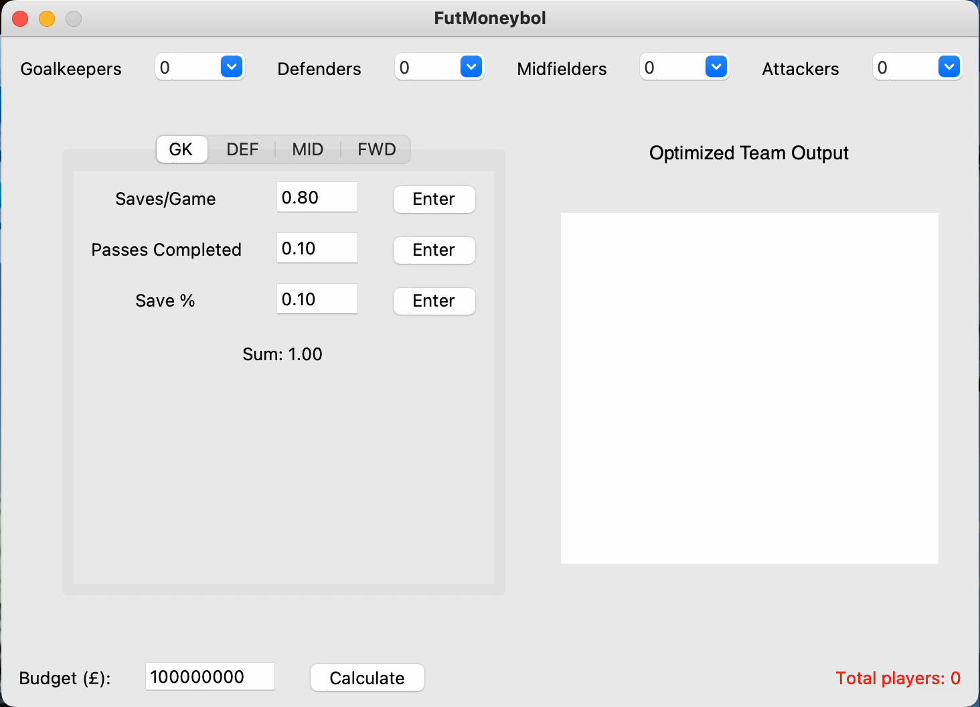
GUI Demonstration

Slide 12
Thank You

